Slide 1
NIHR Financial Assurance Funding (FAF) Workshop

Slide 2
WELCOME FROM PROFESSOR DAME LOUISE ROBINSON
Notes:
Louise to do

Slide 3
Who are NIHR?
NIHR is the nation’s largest funder of health and care research and provide the people, facilities and technology that enables research to thrive.
The NIHR Global Health Research programme supports high-quality applied health research for the direct and primary benefit of people in low and middle-income countries (LMICs), using Official Development Assistance (ODA) funding.
#nihrglobalhealth
https://www.nihr.ac.uk/explore-nihr/funding-programmes/global-health.htm
Notes:
Louise to do

Slide 4
ODA FUNDING – WHAT IS THIS?
Official Development Assistance (ODA), often referred to as aid, is the internationally agreed criteria for funds provided to developing countries or multilateral institutions to fight poverty and promote development.
NIHR promotes internationally outstanding applied global health research for the direct and primary benefit of patients and the public in low and middle income countries (LMICs) on the Development Assistance Committee (DAC) list.
Notes:
Louise to do

Slide 5
Research Management
What do you currently know about research management
What challenges do you face with research management?
Best practice – what do you do?
Newcastle University Project Management Toolkit
https://newcastle.sharepoint.com/hub/projectandchangemanagement/Pages/ProjectManagementToolkit.aspx
Notes:
Sharon to do
Sit partners in groups and give them coloured post its, get them to add to the flip chart
Challenges faced in Newcastle complexity of working with different sites in different countries, varied working practices, communication establishing best way for this
Newcastle best practice – Sharing ideas between Research Managers being part of a network, use Teams as a communication aid, hold regular meetings, carry out initiation meetings with finance, contracts etc. at start of project. Hold Steering group meetings, ensure everyone knows there roles and responsibilities

Slide 6
COMPLIANCE AND REPORTING IN THE UK
NIHR Requirements
Newcastle Requirements
Notes:
Terry to do
NIHR require quarterly finance reporting, annual reports, copies of all outputs ensuring disclaimer is added, confidentiality, data protection. NIHR can carry out informal site visits which are made up of a small team of independent experts, this will require reasonable access at agreed times, one month’s notice will be given for this. All equipment purchased from the project need to be recorded and listed on the annual report, total amount for any one piece of equipment is £5,000 over this it needs to be agreed by NIHR. Corrupt gifts or payments ensure partners do not enter in to or facilitate this. Fraud in relation to receipt of monies needs to be accounted for, transparency of all accounting.
Newcastle require to be kept updated of any changes to the programme of work, changes needed to the funds paid to partner we are not allowed to use money for purposes other than what it was agreed for need to get NIHR confirmation

Slide 7
QUARTERLY FINANCIAL REPORTING
 | Statement of Income and Expenditure:
 | Funder Reference: | GHR Group: 16/137/62
 | Funder: | NIHR
 | Newcastle Finance Reference: | RES/0150/7993
 | Newcastle G&C Reference: | BH170126
 | Collaborator Reference: | Newcastle University
 | PI: | Prof L Robinson
 | Project Title: | NIHR Global Health Group on Dementia Prevention & Enhanced Care - (DePEC)
 | Period of claim: | 01/04/2019 | 30/06/2019
 |  |  |  |  |  |  |  |  | 100% | 80% if applicable
% Funded |  | Period | Basic | NI | Superannuation | Maternity/Paternity | Additional 1 | Additional 2
100% | DI Staff |  | £0.00 | £0.00 | £0.00 | £0.00 | £0.00 | £0.00 | £0.00 | £0.00
 |  |  | Basic | NI | Superannuation | Maternity/Paternity | Additional 1 | Additional 2
 | Name | Date | £0.00 | £0.00 | £0.00 | £0.00 | £0.00 | £0.00 | £0.00 | £0.00
 | Grade
 | Name
 | Grade | Date | £0.00 | £0.00 | £0.00 | £0.00 | £0.00 | £0.00 | £0.00 | £0.00
 | Name
 | Grade | Date | £0.00 | £0.00 | £0.00 | £0.00 | £0.00 | £0.00 | £0.00 | £0.00
 | Name
 | Grade | Date | £0.00 | £0.00 | £0.00 | £0.00 | £0.00 | £0.00 | £0.00 | £0.00
 | Name
 | Grade | Date | £0.00 | £0.00 | £0.00 | £0.00 | £0.00 | £0.00 | £0.00 | £0.00
 | Name
 | Grade | Date | £0.00 | £0.00 | £0.00 | £0.00 | £0.00 | £0.00 | £0.00 | £0.00
 | Name
 | Grade | Date | £0.00 | £0.00 | £0.00 | £0.00 | £0.00 | £0.00 | £0.00
100% | DI Consumables |  | £0.00 |  |  |  |  |  | £0.00 | £0.00
100% | DI Travel & Subsistence |  | £0.00 |  |  |  |  |  | £0.00 | £0.00
100% | DI Other Costs |  | £0.00 |  |  |  |  |  | £0.00 | £0.00
100% | DI Conference Fees |  | £0.00 |  |  |  |  |  | £0.00 | £0.00
100% | FEC |  | £0.00 |  |  |  |  |  | £0.00 | £0.00
 | Total Claim |  |  |  |  |  |  |  | £0.00 | £0.00
Notes:
Terry to do
All expenditure must be reported on the basis of actual expenditure incurred, detailed accounting records of all expenditure

Slide 8
ACCURATE FORECASTING FIGURES
 | FORECASTING |  |  | To 31st March 2018 |  | To 31st March 2019 | To 31st March 2020 |  | To 30th July 2020
 | Please ensure this forecast is as accurate as possible
 | Please see PROCESS tab for guidance on how to complete this document
 | DI Staff Costs |  |  |  |  | £ | £ |  | £
 | DI Consumables |  |  |  |  | £ - | £ - |  | £ -
 | DI Travel & Subsistence |  |  |  |  | £ - | £ - |  | £ -
 | DI Other |  |  |  |  | £ - | £ - |  | £ -
 | DI Conference Fees |  |  |  |  | £ - | £ - |  | £ -
 | DA - Investigators |  |  |  |  | £ - | £ - |  | £ -
 | DA - Estates |  |  |  |  | £ - | £ - |  | £ -
 | DA - Other
 | Indirect Costs |  |  |  |  | £ - | £ - |  | £ -
 | TOTAL |  |  | £ - |  | £ - | £ - |  | £ -
Notes:
Terry to do
Explain need for accurate forecasting staff costs should be easier, think about forthcoming workshops, visits, travel etc. think about your milestones in your workstream is there are any community travel for interviews etc. when will these take place look to put in correct year. Need to notify us immediately of any variances from planned expenditure, if there are any significant deviations from the actual expenditure and previously submitted forecast we will need to state the reasons for this to NIHR.
Reasons for accurate reporting: The NIHR Global Health programmes forms part of the wider Department of Health and Social Care (DHSC) ODA budget. Accurate forecasting of ODA cash expenditure is essential as DHSC contributes to meeting the governments legal requirement to spend 0.7% of Gross National Income (GNI) on ODA each calendar year. HM Treasury closely monitor DHSC ODA calendar year forecasts against target spend and future DHSC funding may be a risk if DHSC forecasts are not delivered.

Slide 9
TIME SHEETS
Hours per day/week/month on this project
Hours per day/week/month on other things
Annual leave
Sickness and other absences
Notes:
Sharon to do
We know it is possible for people to be working on more than one project at a time. We are required to keep accurate records to ensure we are claiming the correct hours/amounts from the funder. To do this we record hours worked using a timesheet, an example of which is on the screen and we can provide you with this to use.

Slide 10
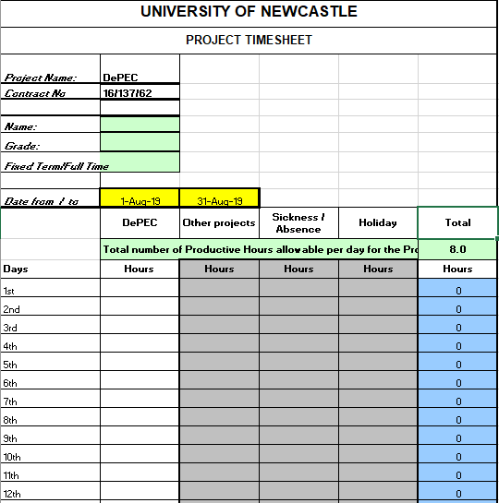
Notes:
Sharon to do

Slide 11
Travel (Newcastle Guidelines)
Mileage – 45p per mile for first 200 miles then 25p per mile over this
Trains/flights – standard/economy fare
Accommodation
£165 per night for London
£120 per night for rest of UK
£165 per night for rest of the world
Subsistence - £20 for lunch, £35 for dinner (snacks up to £10/day in the UK)
Notes:
Terry & Sharon to do
Ask first if the partner has guidelines in their own institution if yes could we have a copy
As there are no NIHR guidelines using Newcastle i.e. cost and value for money for all travel, safety and wellbeing and commitment to reduce carbon emissions. Travel should be standard and not first class and preferably booked through an approved travel agent. Mileage charged at 45p per mile for first 200 miles then 25p per mile over this, parking charges will be covered, cars should be roadworthy and hold valid insurance. Accommodation should be safe and if possible booked through an approved travel agent costs should be in line with average rates i.e. for Newcastle London as centre £165 other parts of the UK £120 with the rest of the world at £165. Subsistence not exceeding £20 for lunch and £35 for dinner, snacks up to £10 in 24 hour period.

Slide 12
RECEIPTS
To provide evidence of correct use of funds
Public funds needs to be transparent
Ensure funds are being used as per agreement with NIHR
Notes:
Sharon and Terry to do
Stress importance of keeping records of expenditure, Newcastle accountable for any missing receipts and would need to cover funds, use or receipts books or printed blank receipts

Slide 13
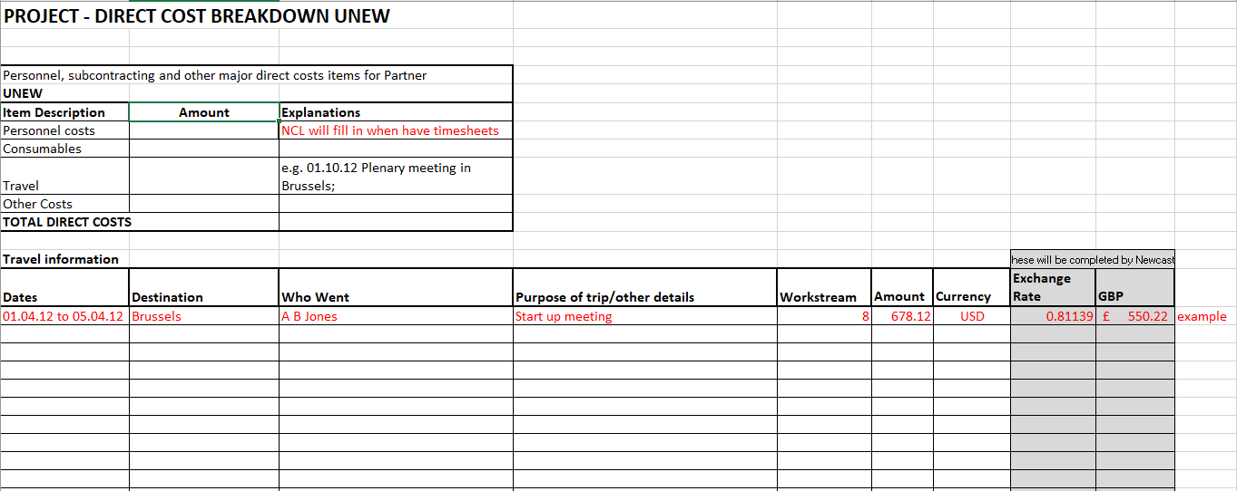
Notes:
Sharon to do

Slide 14
AUDIT
Records need to be kept for six years following end of project
NIHR can give one month’s notice to carry out site visits
Audits will include NIHR looking at expenditure and receipts – need to ensure these match
Notes:
Sharon and Terry to do
Penalties – Contracted to funder must follow their guidelines, need to maintain evidence, could have funding withdrawn, reputation could be at risk, fraud potential criminal prosecution

Slide 15
DISCLAIMER STATEMENT FOR OUTPUTS
This research was funded by the National Institute for Health Research (NIHR) [Dementia Prevention & Enhanced Care (DePEC) (16/137/62)] using UK aid from the UK Government to support global health research. The views expressed in this publication are those of the author(s) and not necessarily those of the NIHR or the Department of Health and Social Care
Notes:
Terry to do
Discuss the challenges that Newcastle face – tight deadlines from NIHR, regular changes from NIHR when requesting information reason for this still in settling in/developing period.

Slide 16
GFGP ACCREDITATION
Michaela Goodson
Notes:
Michaela to do

Slide 17
WHAT IS GFGP?
A programme that was originally developed in Kenya to strengthen Africa’s research and development infrastructure.
Commonly used by UKRI to evaluate governance of LMIC research institutes
It is an innovative standard to set up the best practices in management of funds awarded to grantees.
More information at: www.aesa.ac.ke
It’s a self assessment tool to support research institutions to take steps to build up their grant management capacity and resilience enabling institutions to attract more funding and allow funders to gain confidence of ability to manage grants.
Notes:
Michaela to do

Slide 18
WHAT HAPPENS TO THE DATA?
Data is stored by the system and you can give access to grantors to access your assessment, but have to give permission for this.
Notes:
Michaela to do

Slide 19
3 LEVELS
Bronze: Basic assessment 250USD
Silver: more in depth and requires uploading of more policies
Gold: For larger grants and multi country sharing a budget, but also requires more measures in place.
Platinum: more uploads, policies, bigger organisations (whole universities rather than departments).
Grantors can ask or pay for an institution to do the assessment before they decide how much and whether that institute can receive and manage their own finance or whether it needs to be done elsewhere.
For larger grants, it is likely to become mandatory at least at Bronze level.
Notes:
Michaela to do

Slide 20
https://www.globalgrantcommunity.org/login
Notes:
Michaela to do

Slide 21
Notes:
Michaela to do

Slide 22
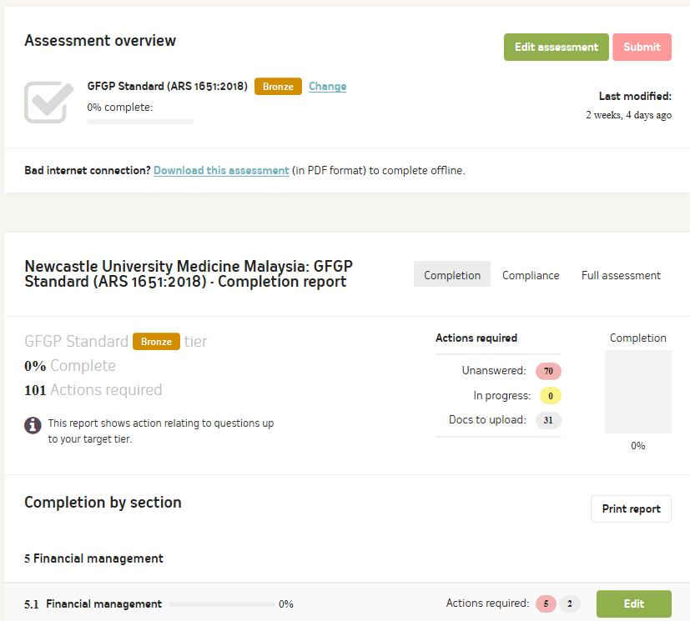
Notes:
Michaela to do

Slide 23
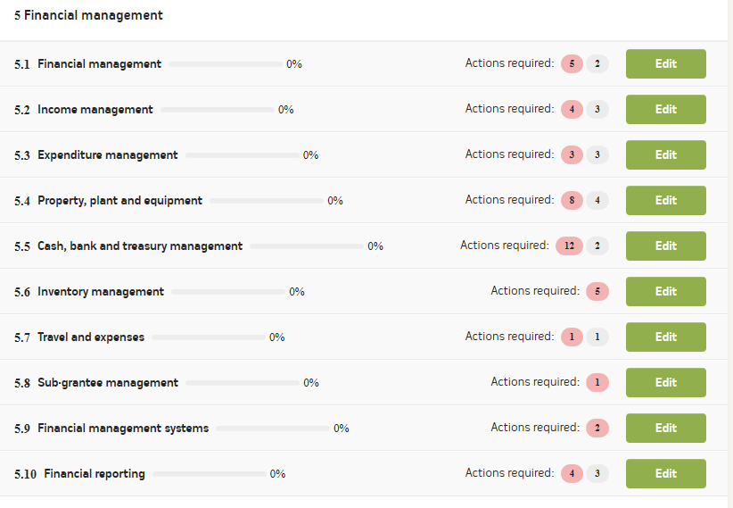
Notes:
Michaela to do

Slide 24
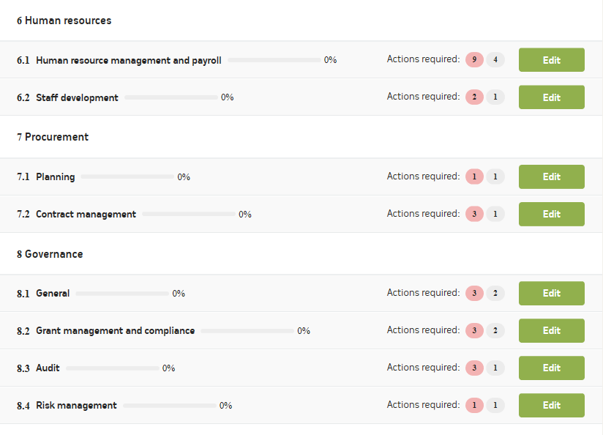
Notes:
Michaela to do

Slide 25
FINANCE – BRONZE EXAMPLE
Notes:
Michaela to do

Slide 26
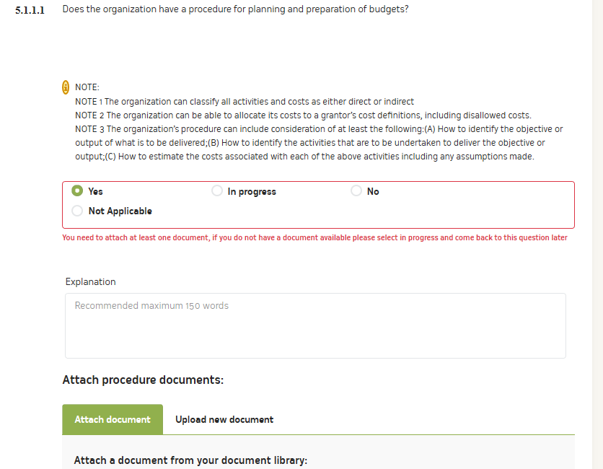
Notes:
Michaela to do

Slide 27
SILVER EXAMPLE
Notes:
Michaela to do

Slide 28
GOLD EXAMPLE
Notes:
Michaela to do

Slide 29
HOW LONG WILL IT TAKE TO COMPLETE?
If policies all made then 1 day to complete
If polices are not there and cant be uploaded, you may not pass the assessment or have to make the policies first and there will be a variable time for approval of policies from the organization.
If an institution is unable to comply with Bronze level standards, it is unlikely that they will be able to compete for further funding or manage their own finances.
Notes:
Michaela to do

Slide 30
AIM
For all the DePEC countries to have completed a Bronze financial assessment before the next meeting or at least found what is missing policy and document wise so that they can achieve the Bronze status.
Notes:
Michaela to do

Slide 31
FURTHER FUNDING AND COSTING OF GRANT APPLICATIONS
Searching for funding opportunities
Costing of grants
Funders guidelines
Submission of application
Notes:
Costing – Value for money, relevant to achieving the objectives of the project, think about salaries (cost of top of scale) think about including finance costs, think about potential travel, workshops, conferences, accommodation, data collection costs, screening, evaluation, development costs and dissemination costs, equipment. All costs must be justifiable
Different platforms for submitting applications, MIS, Je-S, individual funder platforms
Researchfish

Slide 32
Notes:
Sharon and Terry to do

Slide 33
TIPS FOR SUCCESSFUL APPLICATIONS
Make sure you meet all eligibility criteria
Ensure you have high quality plans within the remit of the call and address all the selection criteria
Be clear why this is the right time to be doing this research and what knowledge gap will be filled
Appropriate community engagement and involvement
Plans to build a research collaboration with appropriate mix of relevant expertise
Letters of supporting showing strong institutional commitment
Clear governance and project management
Clear milestones and endpoints
Demonstration of appropriate due diligence and risk management
A clear budget with consideration of value for money
Notes:
Sharon and Terry to do
Funders guidelines read carefully for eligibility, their requirements and what costs are eligible/ineligible

Slide 34
What to Avoid
Being too ambitious, the funder will need to be convinced the programme can be delivered within the time frame and budget. Think about whether you need to be more focussed
Missing a key part of the remit of the call, for example don’t forget to include strong plans for capacity building and ensuring sustainability beyond the end of the funding
Having more partners than you need – this will make your programme more difficult to manage
Presenting a programme that is difficult to follow or overly complex
Notes:
Sharon and Terry to do
Funders guidelines read carefully for eligibility, their requirements and what costs are eligible/ineligible

Slide 35
END OF WORKSHOP
ANY QUESTIONS?

